Slide 1




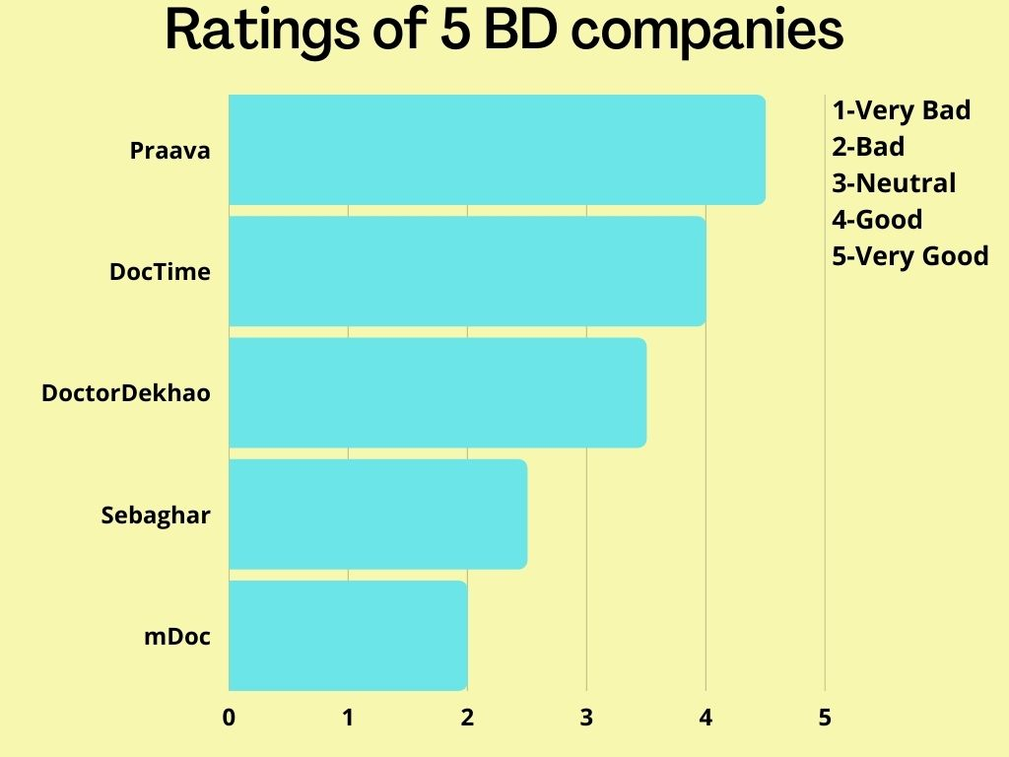





























Case Study on Telemedicine Sector
Md. Amir Abdal Sobhani (2019-1-60-023), Sreya Deb Srestha (2019-1-60-032), Syeda Nawar Shamaem (2019-1-60-110)
Companies with better privacy policies
Companies with poor privacy policies
Praava offers way to opt-out which other companies do not
Praava, DocTime and Doctor Dekhao allow users to update data
Sebaghar and mDoc do not specify the duration of keeping the data
Do not let users know what is collected and how it is used
mDoc does not mantain accuracy and security of data
Praava, DocTime and Doctor Dekhao follow COPPA, Praava specifies about under 13 children
Praava and DocTime protect intellectual property
Do not provide access to update data
No option to opt-out
Do not mention anything about BMDC laws
DocTime follows section 89A of the Code of Civil Procedure, 1908
DocTime mentions PHI which others do not
Shebaghar does not provide protection for data
mDoc does not specify about COPPA
All of them provide strong protection for sensitive data
All three follow BMDC guidelines
Companies with poor terms and conditions
Praava and Doctor Dekhao mention about abiding by the law, but do not specify any section.
Based on GDPR, comparison between Praava (Highest rated) and Sesame (No. 1 in USA)
Companies should be cautious regarding fraud, harassing, bullying, abusive and malicious content. Sebaghar and mDoc do not mention anything about these.
Companies with better terms and conditions
Follows PHI and HIPAA
Avoids DNT
Does not sell data to third party
Does not follow PHI and HIPAA
Does not mention DNT
Not only sells data but also buys from third party
Sources: praavahealth.com, sebaghar.com, doctime.com.bd, doctordekhao.com.bd, mdoc.com, sesamecare.com, gdpr-info.eu
Abbreviation: DNT(Do Not Track), PHI(Protected Health Information) and HIPAA(Heath Insurance Portability and Accountability Act), COPPA(Children’s online privacy protection rule), BMDC(Bangladesh Medical and Dental Council)
Praava, DocTime and Doctor Dekhao take action against fraud, abusive and malicious content

